Slide 1
AI Deep Dive I
Tech Bytes
Summer 2021

Slide 2


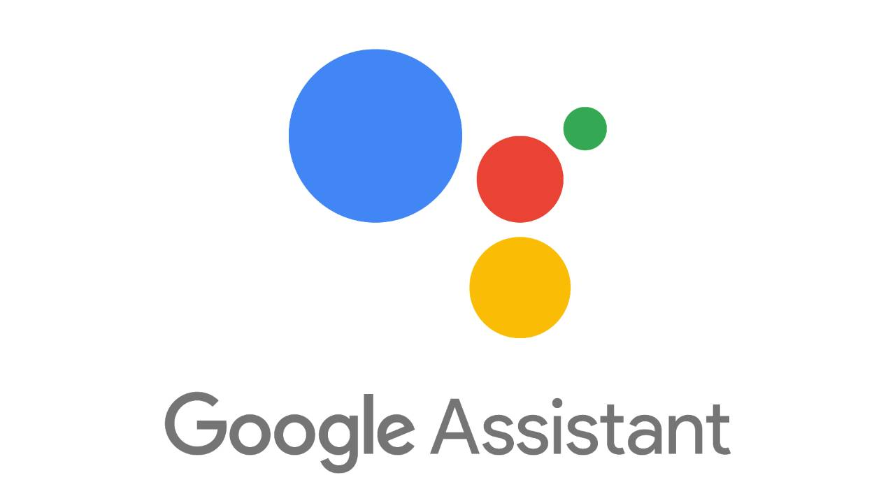
What is AI?
Artificial Intelligence:
noun
The study of computer systems that can creatively or adaptively solve problems
Examples:
Video Game Agents
Self driving cars
Google Assistant / Siri

Slide 3
What is ML?
Machine Learning:
noun
The study of computer algorithms that can optimize themselves without explicitly programmed to solve a problem.
Subsets of Machine Learning
Deep Learning
Reinforcement Learning
Unsupervised / Clustering
Supervised
etc.

Slide 4

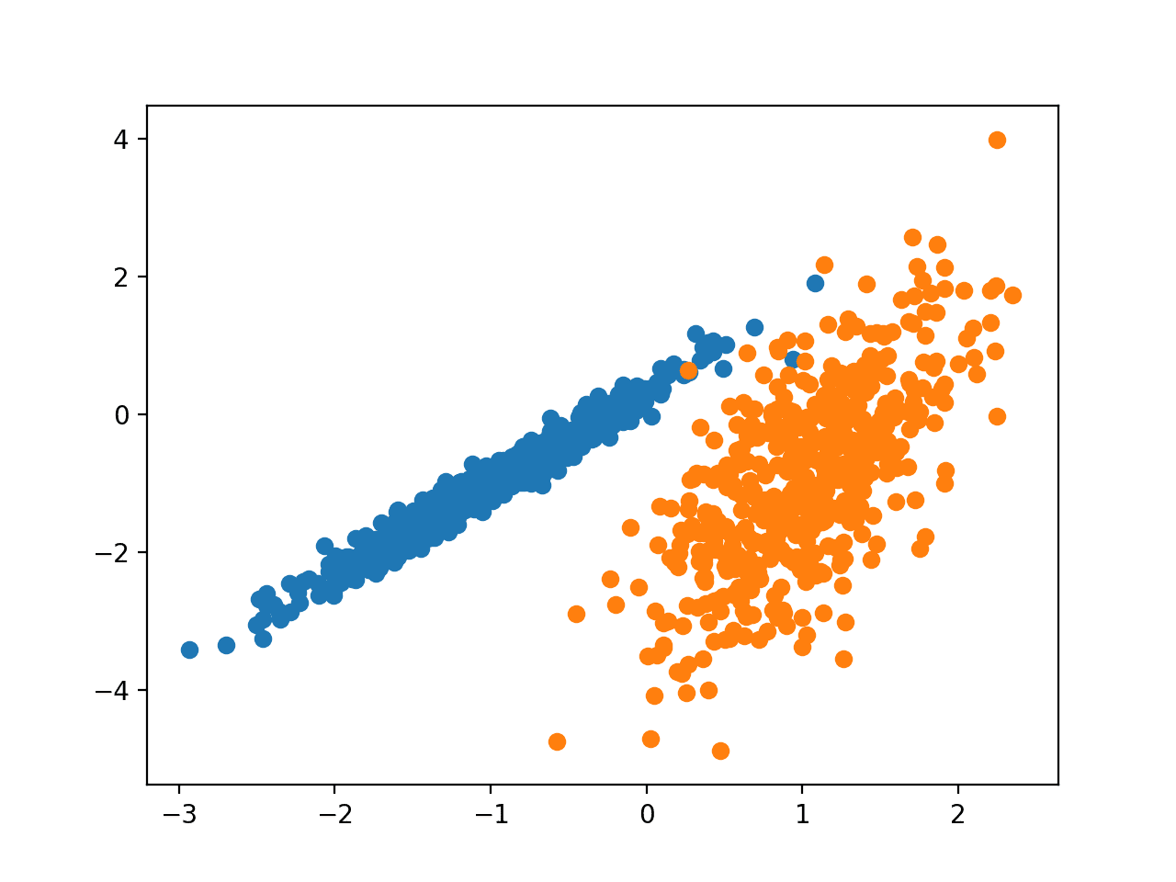
Supervised vs Unsupervised Learning
Supervised Learning:
Training set contains training data and label
ML model tries to learn features that correlate training data to label
“cat”
Unsupervised Learning:
Training set contains only training data
ML algorithm tries to group training data with similar features together

Slide 5
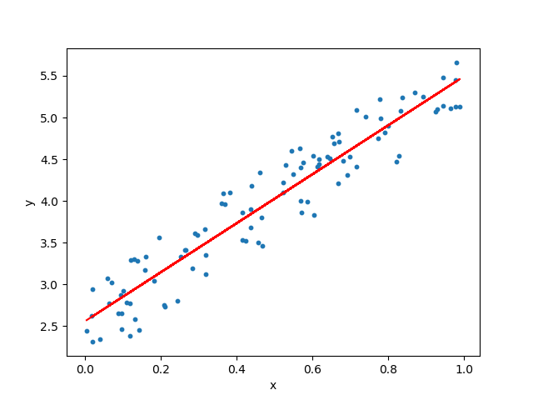
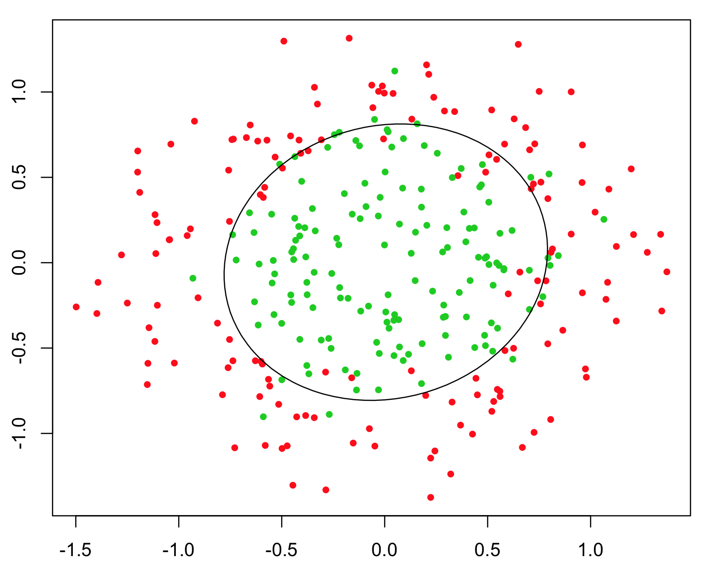
Types of Supervised Learning
Regression:
Your model predicts on a continuous output space
Examples: Height, Population, Coordinates, etc.
Classification:
Your model predicts on a discrete output space
Examples: Animal type, Hand written digits classification, Scene classification

Slide 6
References
https://en.wikipedia.org/wiki/Van_cat#/media/File:VAN_CAT.png
https://medium.com/@uriitai/clustering-in-metric-spaces-42e830b0ded2
https://upload.wikimedia.org/wikipedia/commons/c/cb/Google_Assistant_logo.svg
https://imgs.developpaper.com/imgs/a97e0c2063fc11ea83daff02656c39f6.png
https://blog.csdn.net/tianyaleixiaowu/article/details/80608943
https://oyster.ignimgs.com/mediawiki/apis.ign.com/genshin-impact/a/a2/Genshin_Impact_20201013085252.jpg?width=960
https://cdn.mos.cms.futurecdn.net/My5FvfDGne9p4kRsiNcQEP-1024-80.jpg.webp

